Slide 1
Model Performance Measures

Slide 2

Power of a test
A new data point (shown with “?”) needs to be classified i.e. does it belong to class A or B.
Given the distribution, closer the point is to the origin, it is unlikely to belong to class A. Farther away it is from the origin, likely it belongs to class B
The question is , given the query point, does it belong to red cluster or blue cluster
?

Slide 3
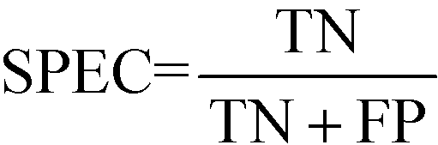
Confusion Matrix
Confusion Matrix – A 2X2 tabular structure reflecting the performance of the model in four blocks
Accuracy – How accurately / cleanly does the model classify the data points. Lesser the false predictions, more the accuracy
Sensitivity / Recall – How many of the actual True data points are identified as True data points by the model . Remember, False Negatives are those data points which should have been identified as True.
Specificity – How many of the actual Negative data points are identified as negative by the model
Precision – Among the points identified as Positive by the model, how many are really Positive
Confusion Matrix | Predicted Negative | Predicted Positive
Actual Negative | True Negative | False Positive
Actual Positive | False Negative | True Positive

Slide 4
Confusion Matrix contd.
Assume model is identifying defaulters. In this binary classification defaulter class is class of interest and labeled as +ve (positive - 1) class, other class is –ve (negative - 0)
True Positives - cases where the actual class of the data point and the predicted is same. For e.g. a defaulter (1) predicted as defaulter (1)
True Negatives – cases where the actual class was non-defaulter and the prediction also was non-defaulter
False Positives – cases where actual class was negative (0) but predicted as defaulter (1)
False Negatives – cases where the actual class was positive (1) but predicted as non-defaulter (0)
Ideal scenario will be when all positives are predicted as positives and all negatives are predicted as negatives

Slide 5
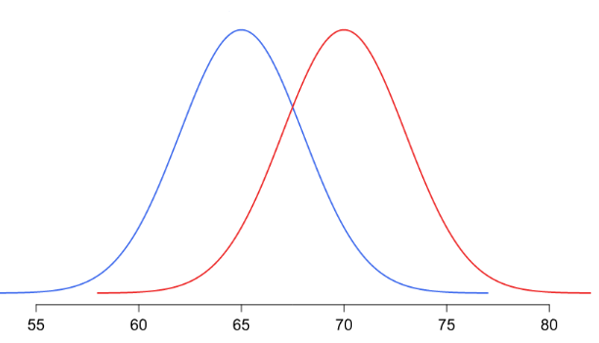
In practical world this will never be the case. There will be some false positives and false negatives
Our objective will be to minimize both but the problem is, when we minimize one the other will increase and vice versa!
The problem is in the overlap region in the distributions
Objective will be to minimize one of the error types, either the false positive or false negative
Threshold
Non-default
Default
Problem region
Attribute x

Slide 6
Minimize false negatives - if predicting a positive case as negative is going to be more detrimental for e.g. predicting a cancer patient (positive) as non-cancer (negative)
Minimize false positives – if predicting a negative as positive is going to be more detrimental for e.g. predicting a boss’s mail as spam!
Accuracy – over all correct predictions from all the classes to total number of cases. Should rely on this metrics only when all classes are equally represented. Not reliable if class representation is lopsided as algorithms are biased towards over represented class
Precision - TP/ TP+ FP. When we focus on minimizing false positives, TP will increase but along with it FP will also increase. How much increase in TP starts hurting (due to increase in FP) ?
Recall – TP / TP + FN : When we focus on minimizing false positives. Recall and precision will oppose each other. We want recall to be as close to 1 as possible without precision being too bad

Slide 7
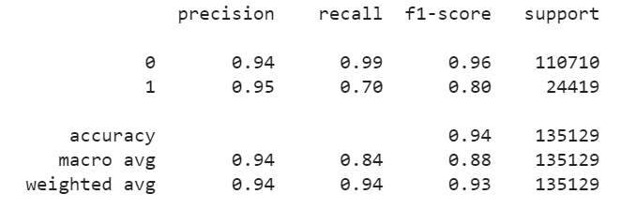
Classification Report
F1-score = Harmonic Mean(Precision, Recall)

Slide 8
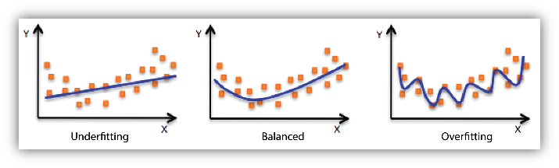
Overfitting vs Underfitting
Overfitting: Good performance on the training data, poor generliazation to other data.
Underfitting: Poor performance on the training data and poor generalization to other data.

